Slide 1
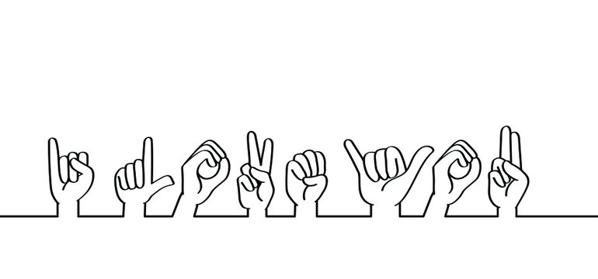


Outline
Sign Language Detection using YOLOv5

Slide 2
MEET OUR TEAM
Ahmed Mohamed Shawky
Salah Adel Gomaa
Mahmoud Sami rizk
Fares Fathy
01204299617
amamasa121212@gmail.com
01020648485
salahadel281@gmail.com
01011419638
Mahmoudsamyrizk@gmail.com
01111166223
ffathy.tdx@gmail.com

Slide 3

Outline
Introduction
Background
Methodology
Results
Conclusion

Slide 4
INTRODUCTION to sign language detection
Outline
our project on sign language detection and translation aims to help people who use sign language to communicate more effectively.
Introduction
Background
Methodology
Results
Test demo
Conclusion
4

Slide 5
INTRODUCTION to sign language detection
Sign language is an essential form of communication for many people, but it can be difficult for those who don't know sign language to understand. My project seeks to address this problem by developing a system that can detect and translate sign language in real-time.
5

Slide 6
Background
Potential Impact
Sign language is an essential form of communication for many people, particularly those who are deaf or hard of hearing .
By enabling people who use sign language to communicate more easily with those who don't, this project has the potential to break down barriers and promote greater understanding and inclusivity.

Slide 7
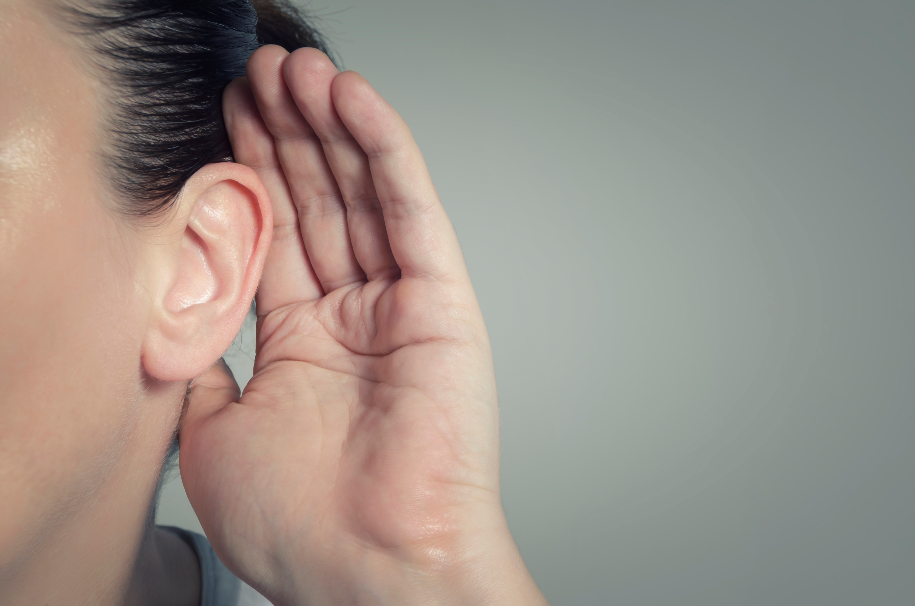
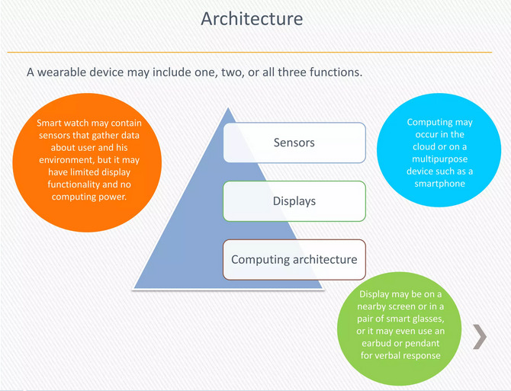
Background
Potential Impact
There are many types of sign language
including American Sign Language (ASL), British Sign Language (BSL), and International Sign Language (ISL). Each type of sign language has its own unique grammar, syntax, and vocabulary.
Sign language is an essential form of communication for many people, particularly those who are deaf or hard of hearing .
By enabling people who use sign language to communicate more easily with those who don't, this project has the potential to break down barriers and promote greater understanding and inclusivity.
7

Slide 8

Background
Potential Impact
Challenges of sign language
One of the biggest challenges of sign language is that it can be difficult for people who don't know sign language to understand. This can lead to isolation and exclusion for people who rely on sign language to communicate.
8

Slide 9
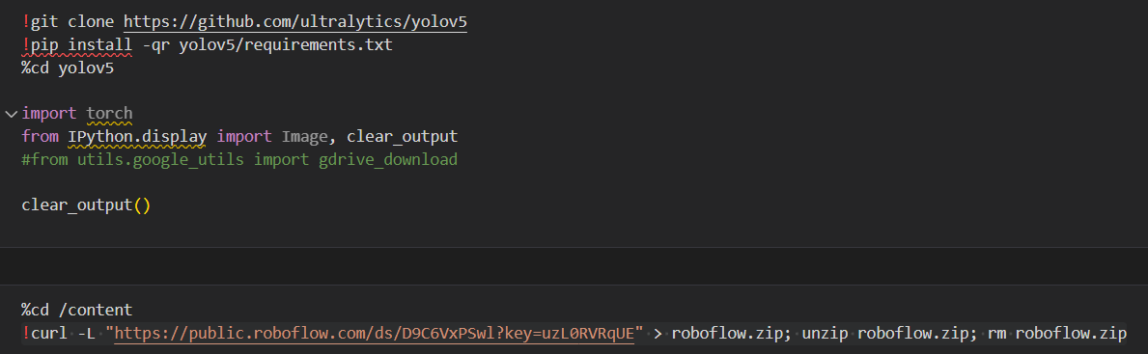
Methodology
This section of the code sets up the environment by cloning the yolov5 model from github and installing the required packages.
Then it downloads the dataset from roboflow using curl command.
9

Slide 10
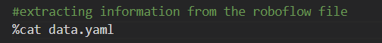
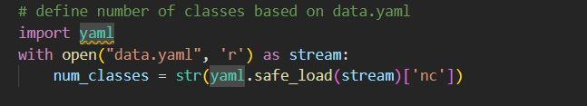
Methodology
After that, the first command displays the content of the yaml file in the notebook such as names of classes detected
Then it extracts the number of classes specified in the file and stores it into ‘num_classes’
10

Slide 11
Methodology
This command trains the YOLOv5 object detection model on the custom dataset using the configuration file and the date file img 416 sets the input image size 416x416 pixels
Batch 32 sets batch size to 32
Epochs 100 trains the model for 100 epochs
Data ../data.yaml specifies path to the data file
cfg ./models/custom_yolov5s.yaml specifies path to configuration file
Cache enables caching for faster training
11

Slide 12
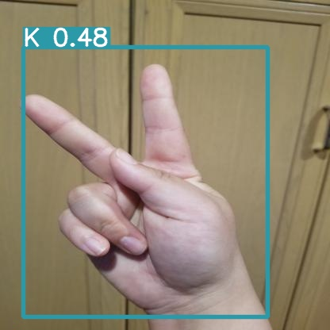
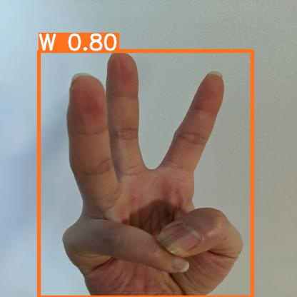
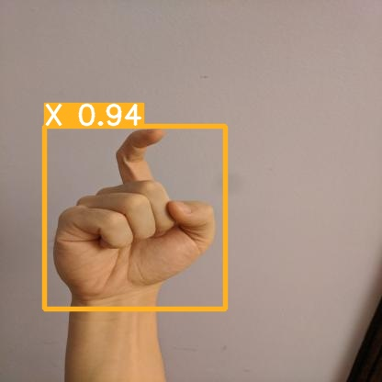
results
12

Slide 13
conclusion
In conclusion, our sign language detection and translation system has the potential to revolutionize the way people who use sign language communicate with those who don't. By breaking down language barriers, it can promote greater inclusivity and understanding.
we plan to expand the scope of my project to include more languages and sign language variations to improve the usability of the system
13

Slide 14

Thank you for your time
Any questions?

